Slide 1
Death is in the Details
Life Lessons Webinar
February 8, 2023

Slide 2
Reminder:
Life Lessons webinars are designed to provide an overview of matters you may wish to consider at different stages of life.
The webinar information does not, and is not intended to, constitute legal or financial advice; instead, all webinar information, content, and materials are for general information purposes only.
Please contact your personal financial advisor or attorney to obtain advice with respect to your specific circumstances.

Slide 3

Your Legacy

Slide 4
Three Directions for your Estate
  Family or other individuals
  Charity
  Government
    Federal government– only if very large estate (over $12.92 million) and are not leaving assets to spouse or charity
    State government - possible inheritance tax depending on state
    Laws of Intestacy – only applies if die without directing where assets go and have no living relatives that can be located

Slide 5
Leaving Money to Family
  Treat family members equally, or allocate based on perceived need?
  Leave money outright to family members or in trust?
  Put everything in writing – don’t rely on someone’s word
  Think twice about naming a family member as executor – use a professional

Slide 6
Leaving Money to Charity
Think about what impact you want your philanthropy to have and which charities you want to support
Do you want to support a specific program, purpose, or area of research?
Do you want to establish your own fund with the charity?
Talk to your family and advisors

Slide 7
Why Notify Charity of Plans?
Can make sure charity is able to use gift as donor intends
  Discontinued programs
  Gift minimums
  Unacceptable restrictions
Can ensure that donor has used correct legal name of charity
Allows charity opportunity to thank donor – recognition and stewardship
Gives donor opportunity to create gift agreement

Slide 8

Gift Agreement
Can be used with will, trust, or beneficiary designation form
Can enhance, but not change, a gift’s wording
Ensures donor’s intent is clear
Can be changed without changing underlying document

Slide 9
susan.hagan@foriowa.org

Slide 10
Your Final Wishes

Slide 11
The Funeral Director’s Role
Transports the remains as needed
Helps facilitate the person’s final wishes
Assisting the family/designee through the process
Provides service assistance
  Churches, funeral home, event venues, etc.
Assistance with obituaries
Death certificates (originates with a Funeral Director)
Social Security notification
Veteran Administration notification

Slide 12
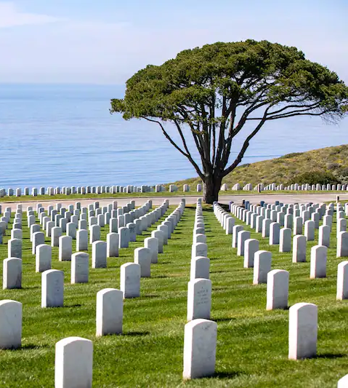
Burial or Cremation or Donation?
Burial
  Traditional burial
  Immediate burial
    No embalming
    Per religious doctrine
  Green burial
Cremation
  Cremated remains can be buried, given to family, scattered per wishes, etc.
Body Donation
  Organ and/or tissue donation
  For research

Slide 13
Pre-planning
Selecting the funeral home
Documenting final wishes
Recommend family members be present when discussing
Pre-payment if desired
Ensures that at a time of sadness, it eases the burden of these decisions

Slide 14
Death Away From Home
If cremation is preferred, a funeral home in that locale may provide the service, as can your preferred funeral home.
If the remains are to be brought home, it is best to work with your preferred funeral home. They will engage the services of another party to assist.
Any death out of the United States is more complex; handled by the Department of State with the assistance of the preferred funeral home.
Your preferred funeral home is your best source of information and assistance.

Slide 15

Settling an Estate

Slide 16
Prepare Information for your Survivors
Simplifies things for family, clients, co-workers
Compile information and let survivors know location of this information (original will, account information, etc.)
Prepare listing of accounts, investments, life insurance, attorney, etc.
Prepare formal document regarding your final remains
Provide sufficient information on beneficiaries and heirs
Provide permission to access digital assets
  Some websites have online tool
  Provide log in and password information

Slide 17
Ways to Transfer Assets at Death
 | Direct Transfer | Joint Ownership | Living Trust | Estate Administration
Assets Controlled | IRAs/401k, POD/TOD, life insurance | Assets jointly titled | Assets titled to the trust | Everything else not designated
Distribution Process | Automatic | Automatic | Governed by trust | Court supervised

Slide 18
Living (or Revocable) Trust
Created while owner is alive through formal documentation
  Assets transferred into the trust
  Trust operates for benefit of beneficiary
  Allows control of distributions to beneficiaries
Assets in trust may avoid probate costs
May provide faster distribution of assets
Does not eliminate the need for a will

Slide 19

Wills
Name a legal guardian for minor children
Name an executor (may charge a fee)
Instruct executor on how to distribute assets
  Those owned individually
  Those not held in a trust
Speed up process of settling estate in courts
If There is No Will
If you die without a will (intestate), the courts
  Appoint guardian for children
  Appoint administrator of estate
  Distribute assets based on intestate succession laws (per state laws)

Slide 20
The Role of Executor/Administrator
Obtain an attorney (determine fees)
Locate original will (if there is a will) and be appointed executor/administrator
Notify heirs/beneficiaries/creditors
  Estate Recovery Program
Gather assets and determine value
File an inventory with the court
File state and/or federal inheritance/estate tax returns if required
File decedent's final tax return if required
Pay off any claims
File estate income tax return
Distribute assets

Slide 21
Questions?

